Slide 1
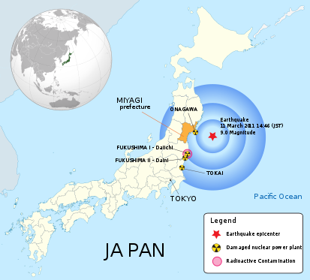
Title: Why is Japan so vulnerable to Earthquakes?
LO: Why was Japan so badly affected by the 2011 earthquake and what makes the country vulnerable to earthquakes?
Title: Why is Japan so vulnerable to Earthquakes?
Success Criteria:
🎌 Meeting: Can describe the main impacts of the 2011 earthquake in Japan and outline why earthquakes happen there.
🏯 Exceeding: Can explain why Japan experiences so many earthquakes and how the 2011 earthquake affected people and places.
🗻 Mastering: Can analyse why Japan is especially vulnerable to earthquakes and evaluate how different factors made the 2011 disaster so severe.

Slide 2



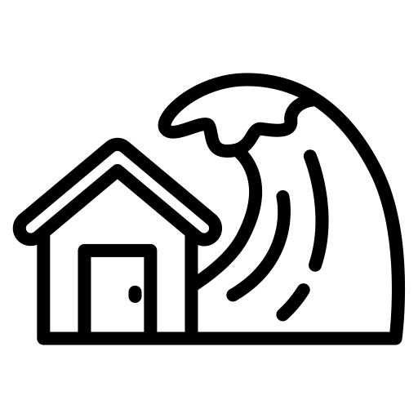
Title: Why is Japan so vulnerable to Earthquakes?
LO: Why was Japan so badly affected by the 2011 earthquake and what makes the country vulnerable to earthquakes?
Key Terms
Aftershock |  | A smaller earthquake that happens after a main earthquake.
Infrastructure |  | The basic buildings and systems (like roads, bridges, and power lines) that can be damaged during an earthquake.
Seismic Activity |  | The shaking or movement of the Earth’s crust caused by the movement of tectonic plates.
Tsunami |  | A large, powerful sea wave caused by an underwater earthquake

Slide 3
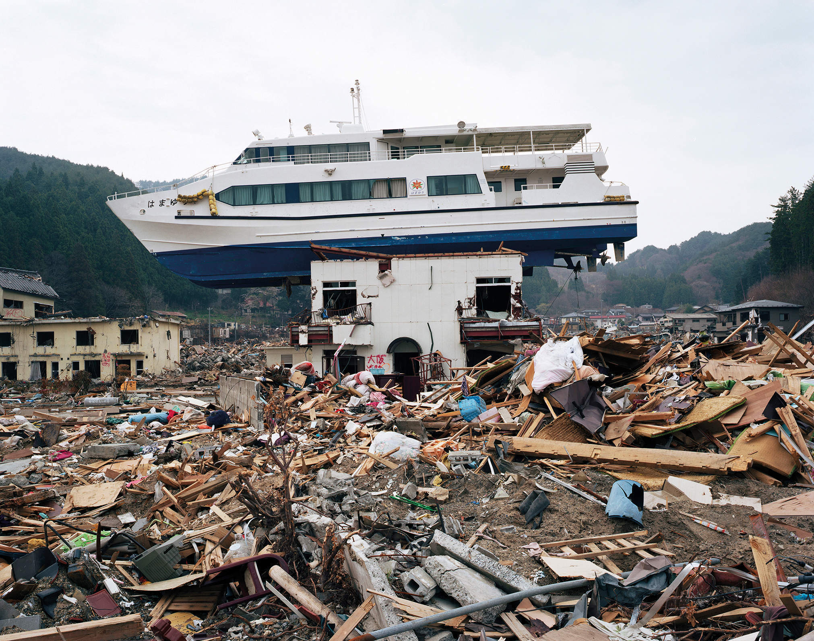
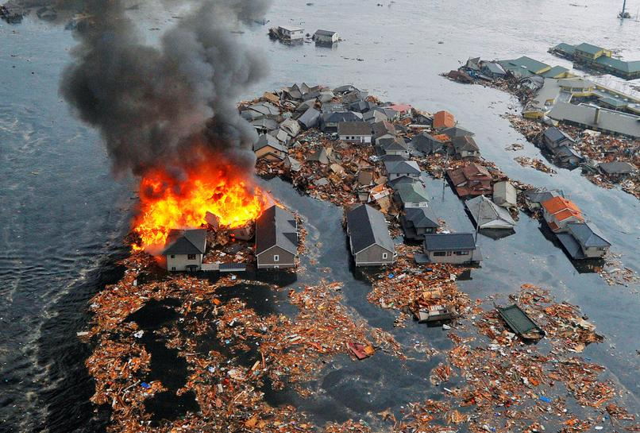
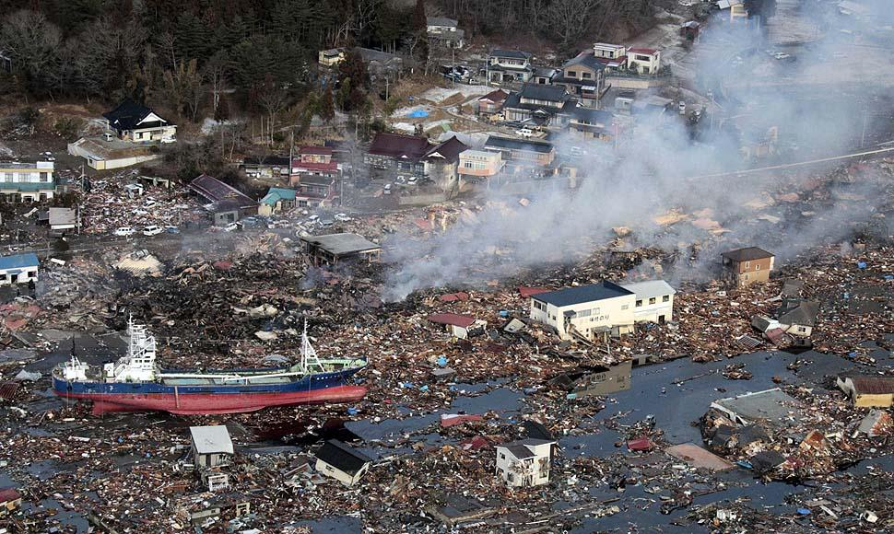
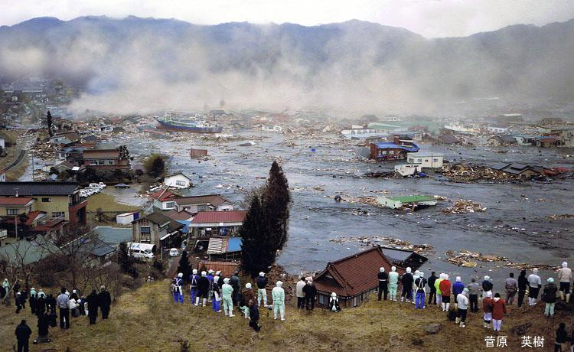
Title: Why is Japan so vulnerable to Earthquakes?
LO: Why was Japan so badly affected by the 2011 earthquake and what makes the country vulnerable to earthquakes?
T – Truth What do you notice in the pictures?
H – Human What features of human geography can you spot in the pictures?
I – Investigate What questions could you ask to find out more about this pictures?
N – Nature What features of physical geography can you see in the pictures?
K – Knowledge Why do tsunamis happen and why are they so dangerous?
THINK like a Geographer:

Slide 4
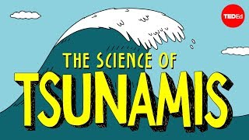
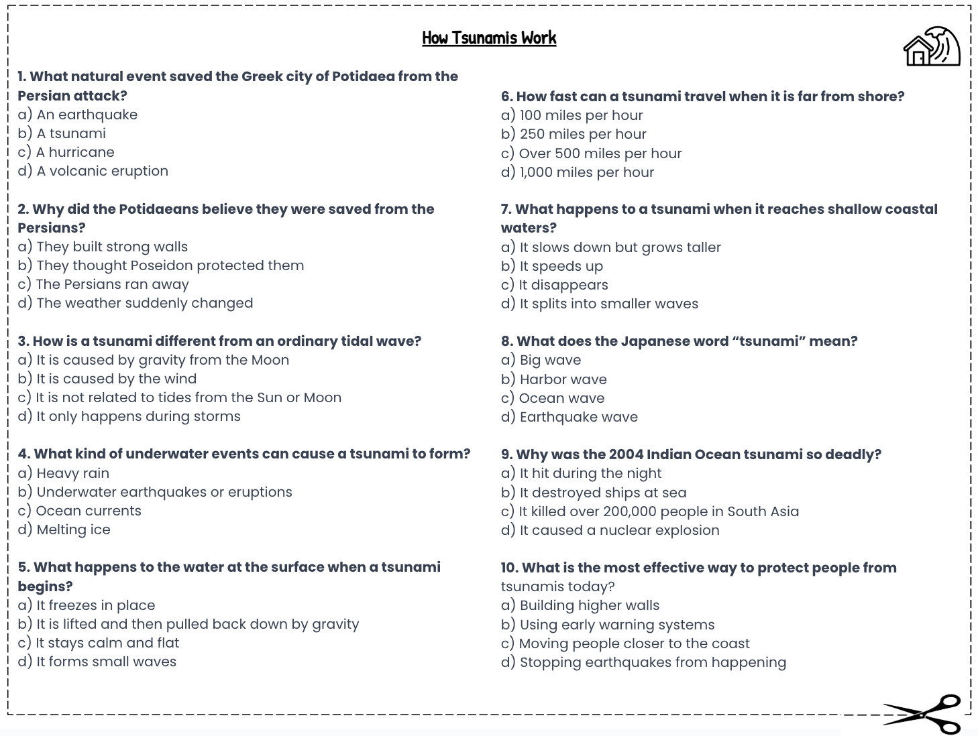
Title: Why is Japan so vulnerable to Earthquakes?
LO: Why was Japan so badly affected by the 2011 earthquake and what makes the country vulnerable to earthquakes?
What is a Tsunami?
Activity 1: Complete the multiple choice questions whilst watching the video:
How Tsunamis Work.
Notes:
https://www.youtube.com/watch?v=Wx9vPv-T51I

Slide 5
Title: Why is Japan so vulnerable to Earthquakes?
LO: Why was Japan so badly affected by the 2011 earthquake and what makes the country vulnerable to earthquakes?
What is a Tsunami?
a) A tsunami
b) They thought Poseidon protected them
c) It is not related to tides from the Sun or Moon
d) Underwater earthquakes or eruptions
b) It is lifted and then pulled back down by gravity
c) Over 500 miles per hour
a) It slows down but grows taller
b) Harbor wave
d) It killed over 200,000 people in South Asia
b) Using early warning systems
GREEN PEN YOUR ANSWERS

Slide 6
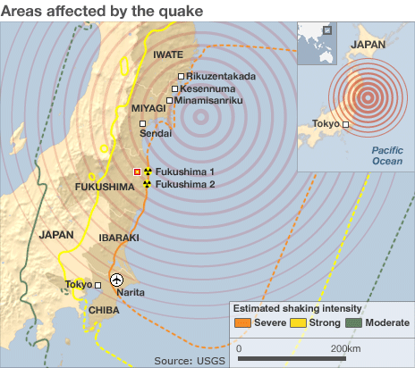
Case study: Japan 2011
Title: Why is Japan so vulnerable to Earthquakes?
LO: Why was Japan so badly affected by the 2011 earthquake and what makes the country vulnerable to earthquakes?
On 11th March 2011, Japan was struck by a massive earthquake 230 miles east of Tokyo.
As a result of the earthquake this triggered a tsunami which spread up to 10km in land in some places with a wave height measuring up to 40m.
A 15m tsunami struck the Fukushima nuclear plant which disabled the cooling system for three of the nuclear reactors causing a meltdown. This supplied 30% of Japan’s electricity.

Slide 7
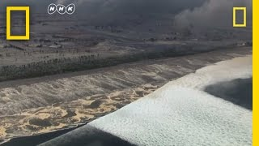
Case study: Japan 2011
Title: Why is Japan so vulnerable to Earthquakes?
LO: Why was Japan so badly affected by the 2011 earthquake and what makes the country vulnerable to earthquakes?
Why were people in Japan able to react quickly after the earthquake struck on March 11, 2011?
How did the power of the tsunami overwhelm Japan’s defences, even though it had the world’s largest seawall?
What can scientists learn from the footage and GPS data collected during the disaster, and how might this help in the future?
Because tsunami warnings were issued immediately and people knew to run to higher ground.
The tsunami was so strong and high that it rose over the 18-foot seawall, flooding and destroying coastal cities.
The evidence helps scientists understand how tsunamis form and move, allowing them to improve warning systems and reduce loss of life in future disasters.

Slide 8
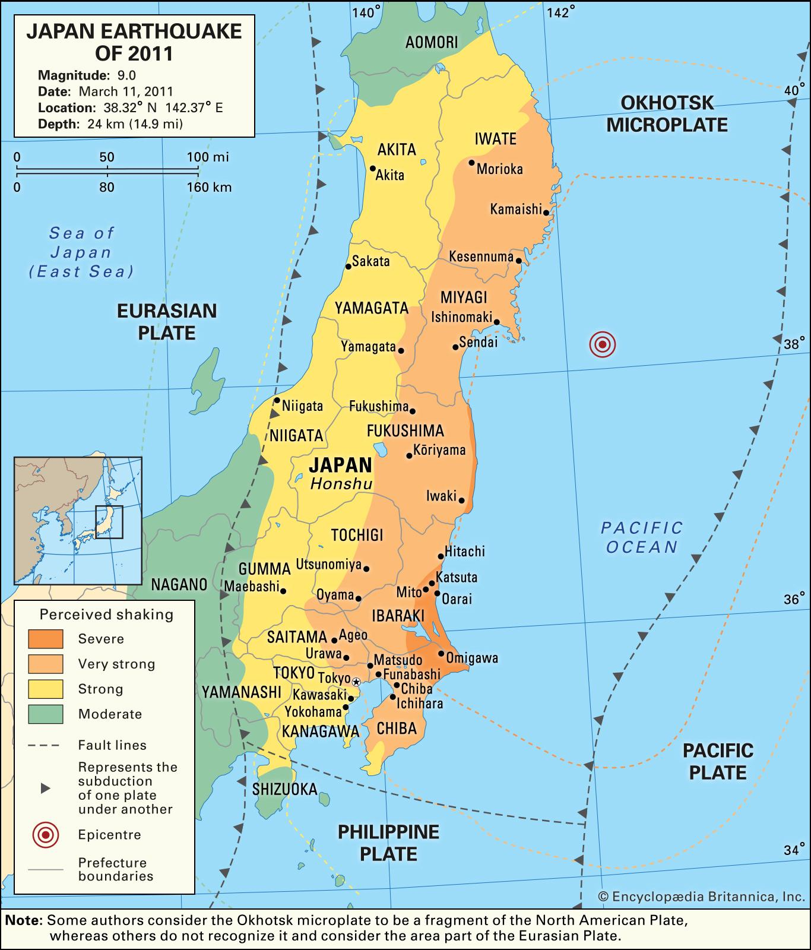
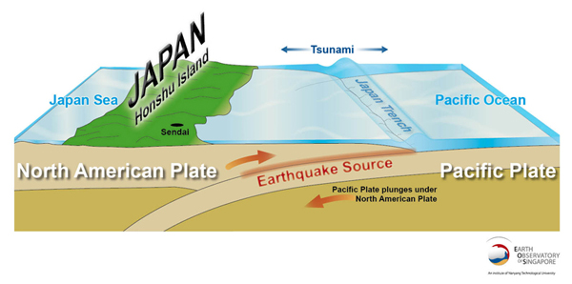
Responses:
There were warnings of the earthquake given to people through their phones, telling them to get to higher ground.
Rescue workers and Japanese soldiers were used to help and the Japanese government requested help from other countries.
Countries such as Australia, China, India, New Zealand, South Korea and America sent teams to help with search and rescue.
Other countries and charities also provided support, such as the Red Cross.
A year later, the Japanese government set up a group to help with building the area
Japan 2011 Tsunami
Knowledge Organiser
When: 11th March 2011
Where: East coast of Japan
What happened: A magnitude 9.0 earthquake occurred off the east coast of Japan which resulted in a large tsunami making its way to Japan.
Plate boundary: Destructive
Death toll (from EQ and tsunami): 20,000 (90% of these deaths were from the tsunami)
Wave height: 40 meters
Secondary Impacts
A tsunami which caused over 17, 000 deaths by drowning
Damage caused to 1.2 million buildings, 2000 roads, 56 bridges and 26 railways as a result of the tsunami
The damage cost US$300 billion
It took nearly 6 months for Japan to start recovering from the loss of business
The tsunami caused environmental damage as it took radioactive material from Fukushima back out to the Pacific Ocean
Primary Impacts
Between 667-1479 deaths that caused by collapsing buildings.
More than 130,000 people were made homeless.
More than 1000 buildings were severely damaged, as well as roads and railways.
Disruption to electric power, water and sewage systems.
The earthquake damaged the main power source that supported several nuclear power stations causing the Fukushima Nuclear Disaster. This was the worst nuclear disaster since Chernobyl in 1986.
On the coast of Okuma in Fukushima there is a nuclear power plant. When the tsunami made landfall it broke over the sea wall in place flooding the nuclear power plant destroying the generators which caused the nuclear power reactors to overheat causing the radiation to enter the air and spread through North East Japan.

Slide 9

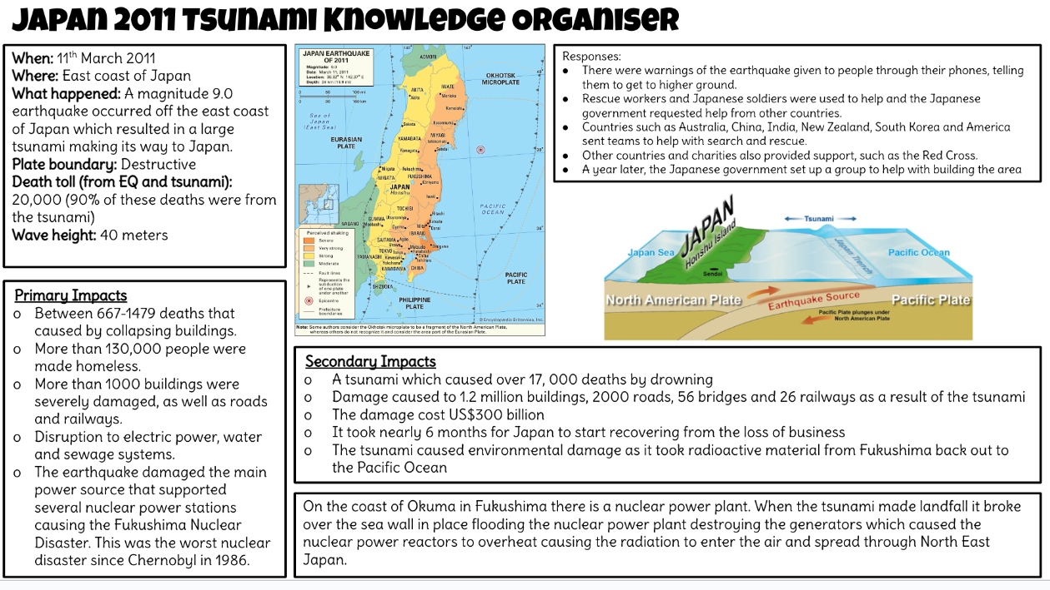


Case study: Japan 2011
Title: Why is Japan so vulnerable to Earthquakes?
LO: Why was Japan so badly affected by the 2011 earthquake and what makes the country vulnerable to earthquakes?
Geography skills: Case Study Creation
Activity 2: Read the knowledge organiser to create a case study summary:
Your summary should include:
An annotated diagram of the tsunami.
What happened?
Social and economic impacts.
Why was this earthquake particularly significant?
Whether the primary or secondary impacts were more severe?
Compare the 2011 Japan earthquake and tsunami with a volcanic eruption you have studied, thinking about their causes, impacts, responses and which was more severe.
Notes:
https://www.youtube.com/watch?v=sasjlpt7zWM

Slide 10
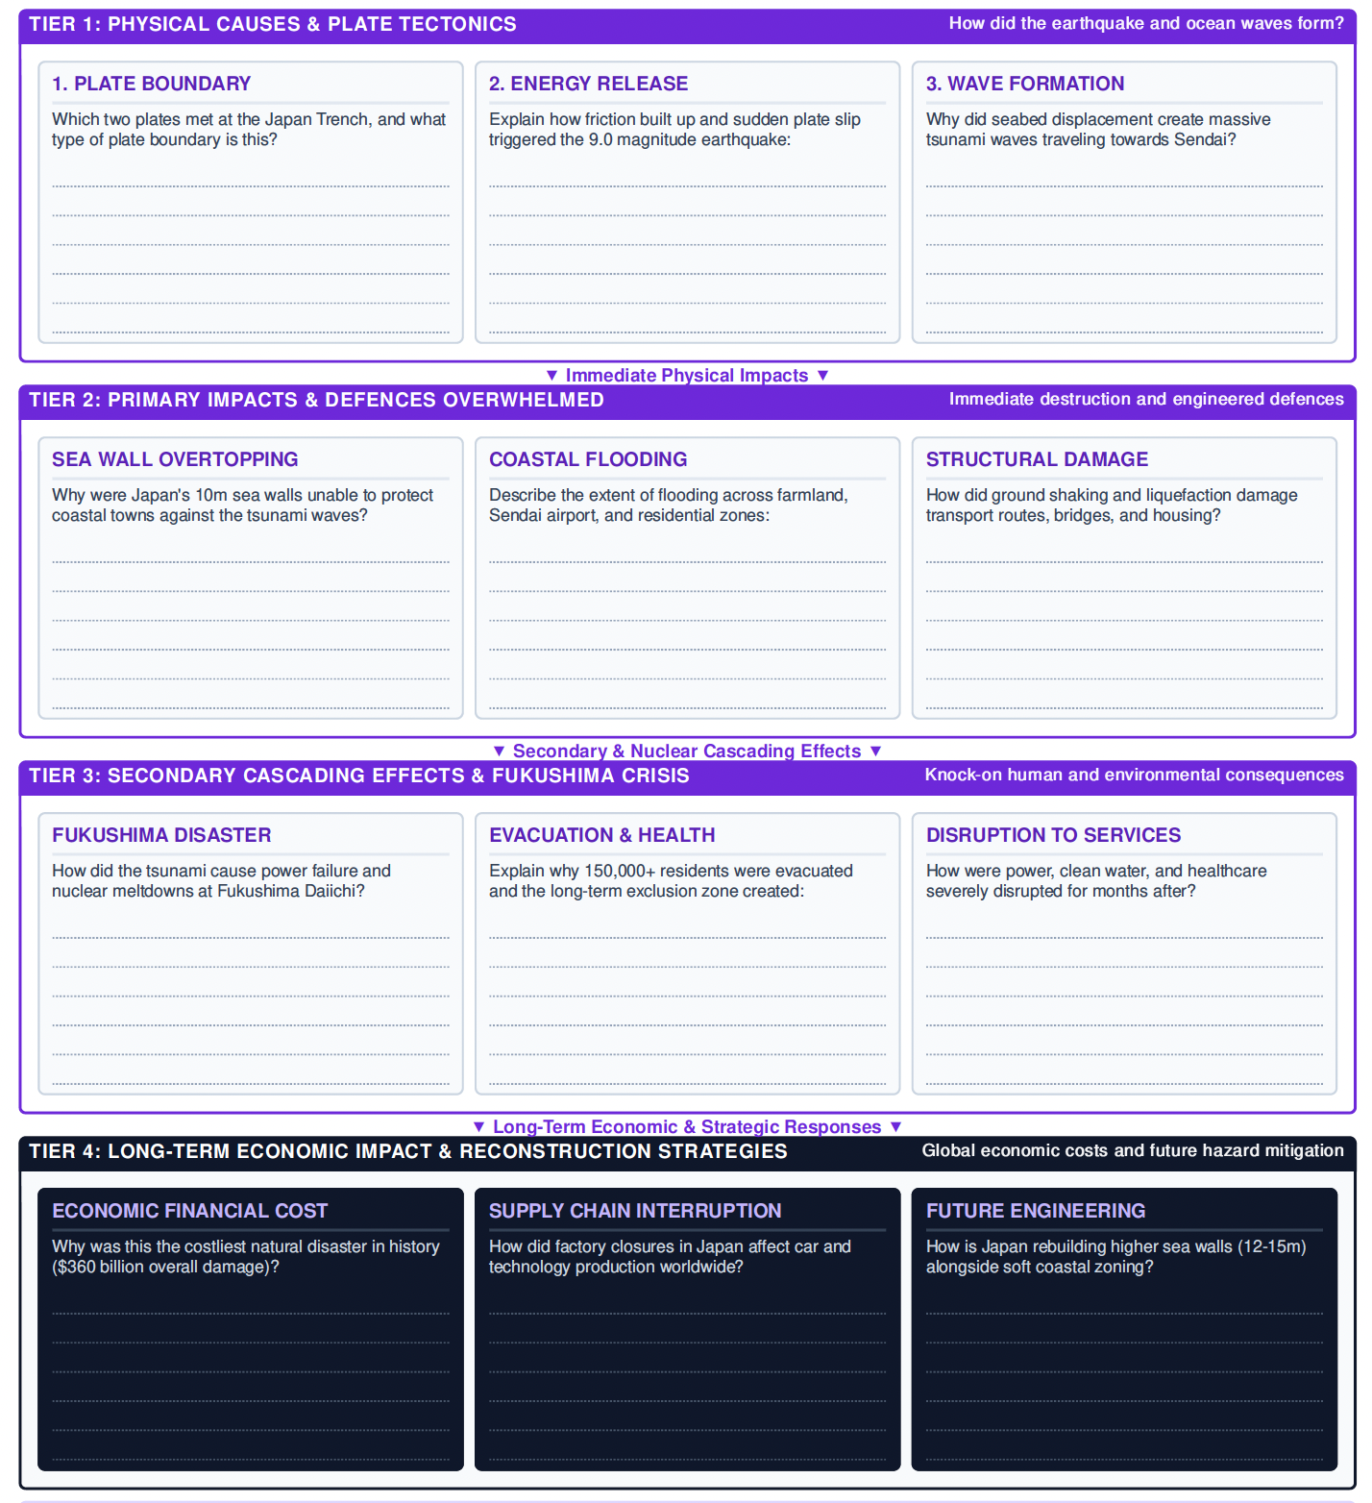
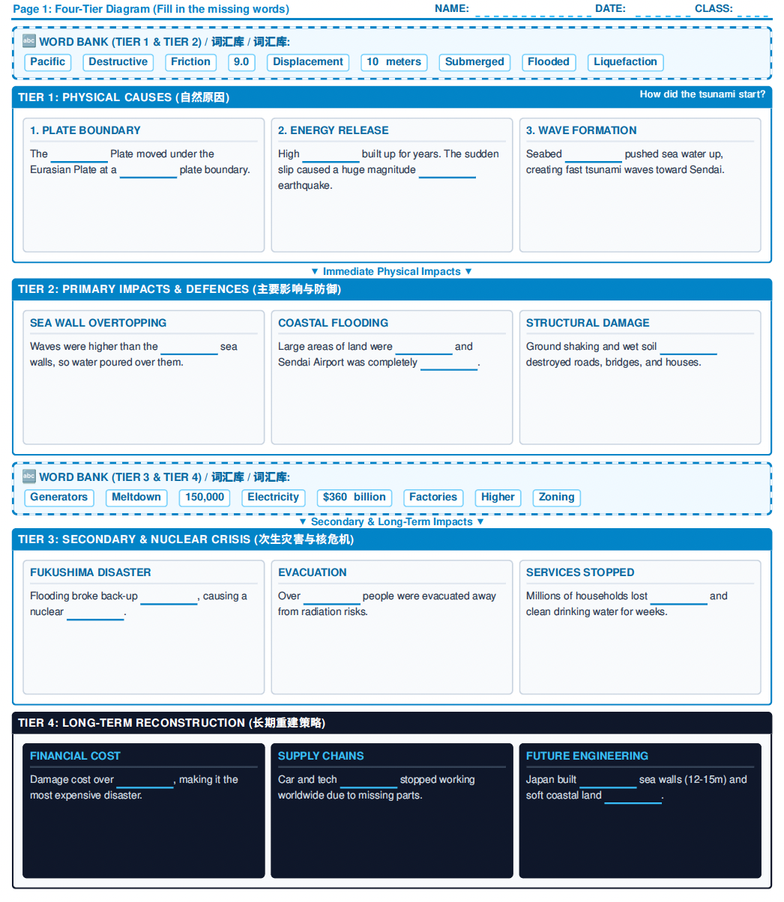

Slide 11
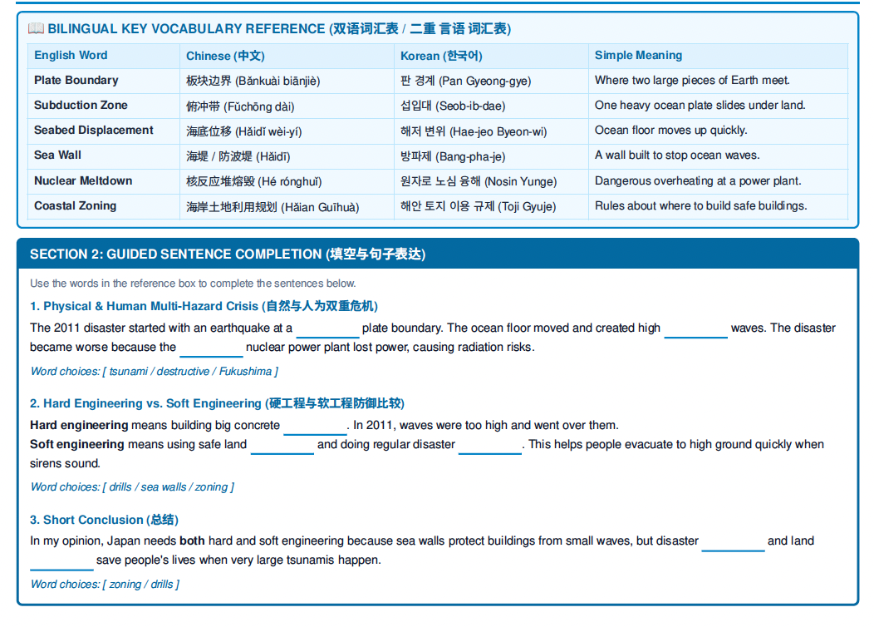
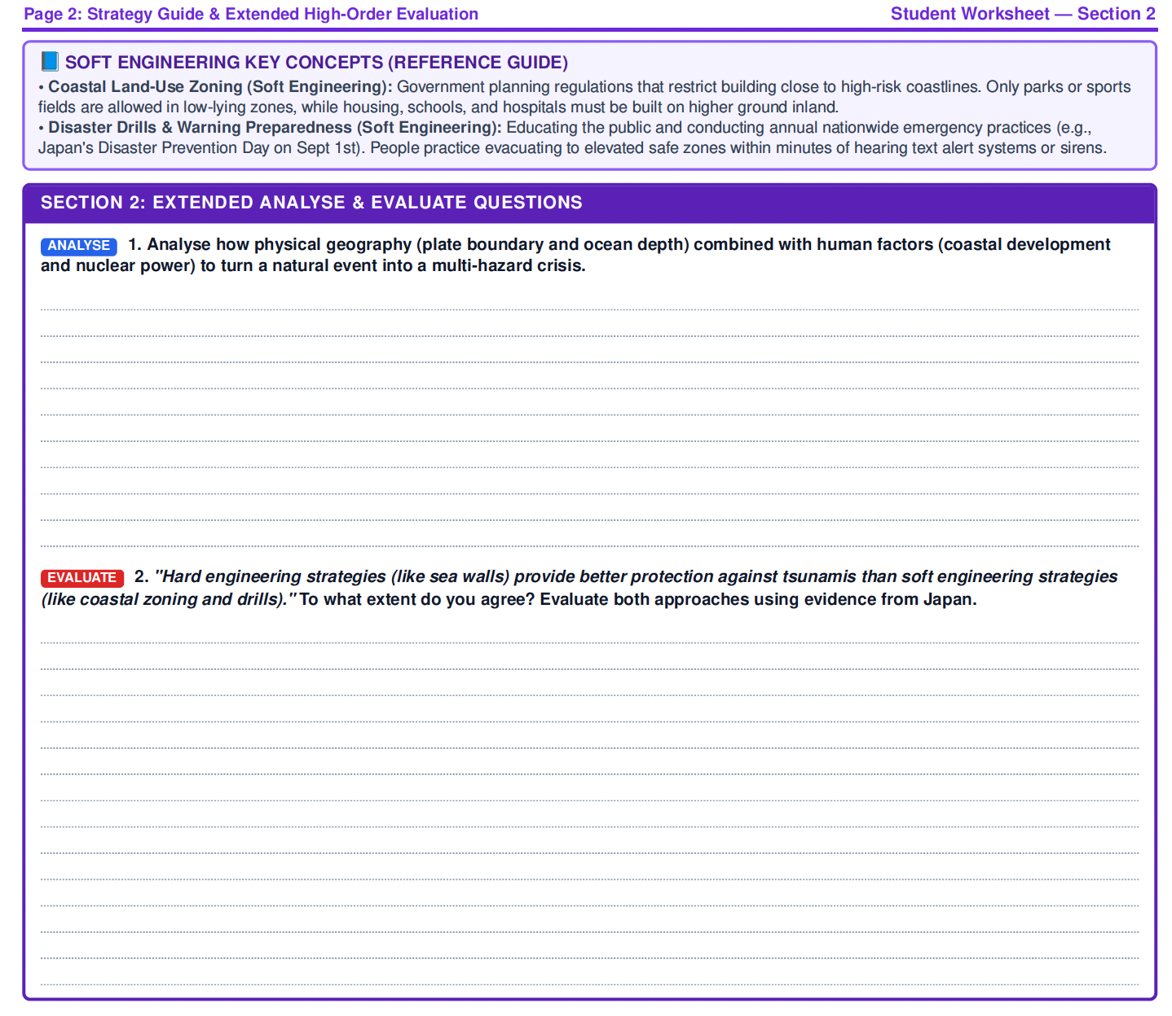

Slide 12

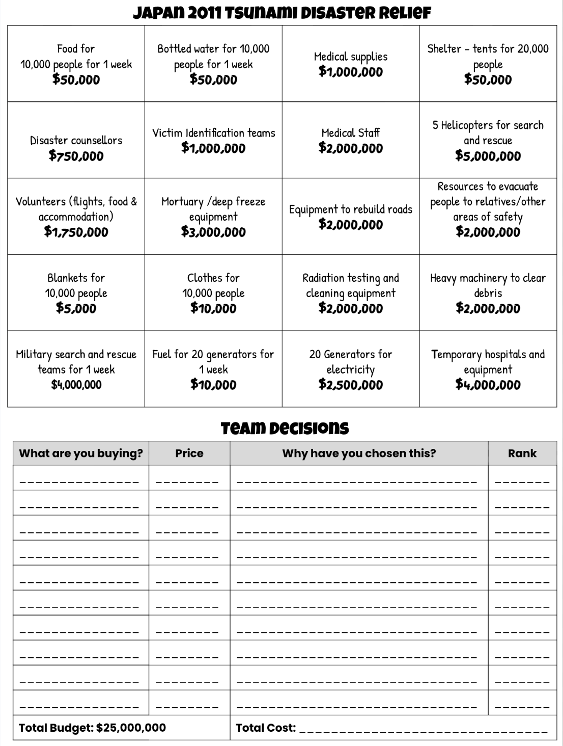
Case study: Japan 2011
Title: Why is Japan so vulnerable to Earthquakes?
LO: Why was Japan so badly affected by the 2011 earthquake and what makes the country vulnerable to earthquakes?
Activity 3: You work for the Red Cross. In your teams, you must decide what aid you will send to help the people of Japan.
It is important that disaster relief teams and aid reach affected areas as soon as possible after the earthquake to minimise the secondary effects.
You have a budget of $25,000,000
Make your choices and complete the decision sheet as a group to explain your choices.
Rank them in order of importance (1 being the most important)
Notes:
https://www.youtube.com/watch?v=geyBSrgLazE&t=13s

Slide 13


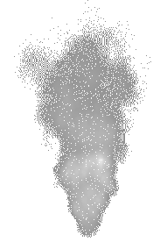
Case study: Japan 2011
Title: Why is Japan so vulnerable to Earthquakes?
LO: Why was Japan so badly affected by the 2011 earthquake and what makes the country vulnerable to earthquakes?
Activity 4: Independent Task:
Explain your top 3 choices. Why do you think these are the best ways to help Japan after the earthquake, tsunami and nuclear meltdown.
Explain why Japan is vulnerable to seismic activity?
Words to use:
Destructive boundary, Earthquakes, Eurasian Plate, Ocean trench, Pacific Plate, Philippine Sea Plate, Subduction, Tsunamis, Volcanoes
Which aid response do you think would be the least effective in helping Japan recover and why?
Which spending choices do you think Japan should make compulsory to help reduce the effects of future earthquakes, and why?
Notes:
https://www.youtube.com/watch?v=KNdjMEcG0mw

Slide 14
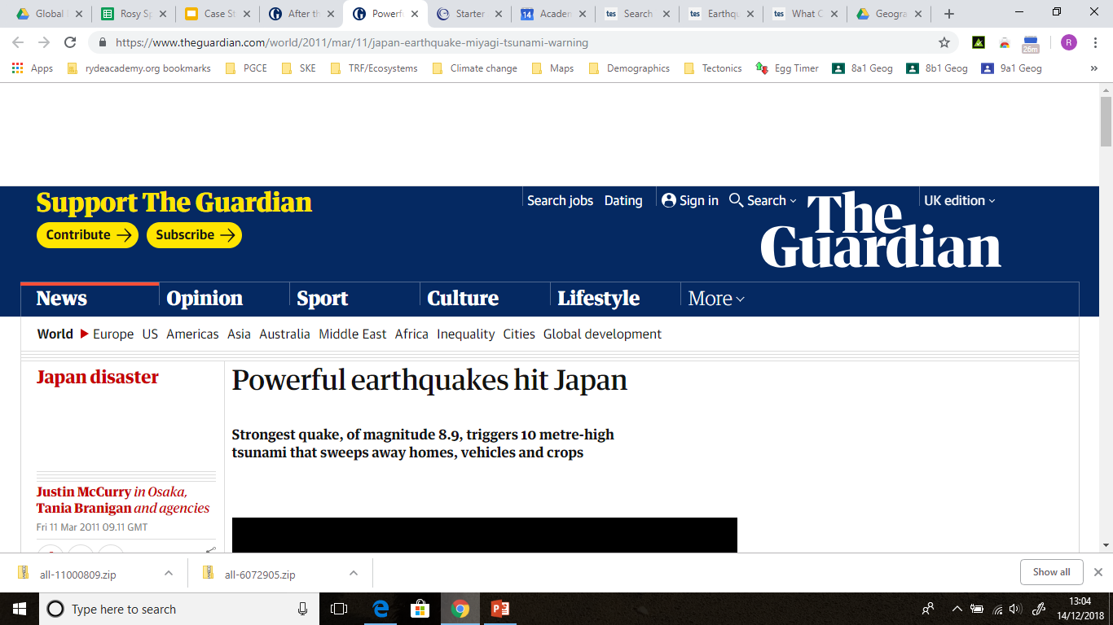

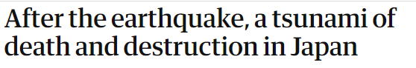
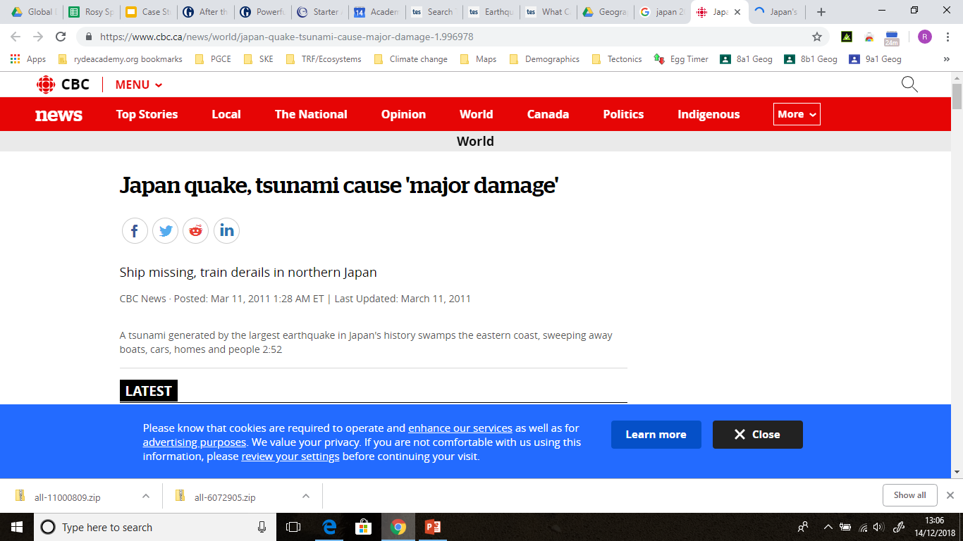
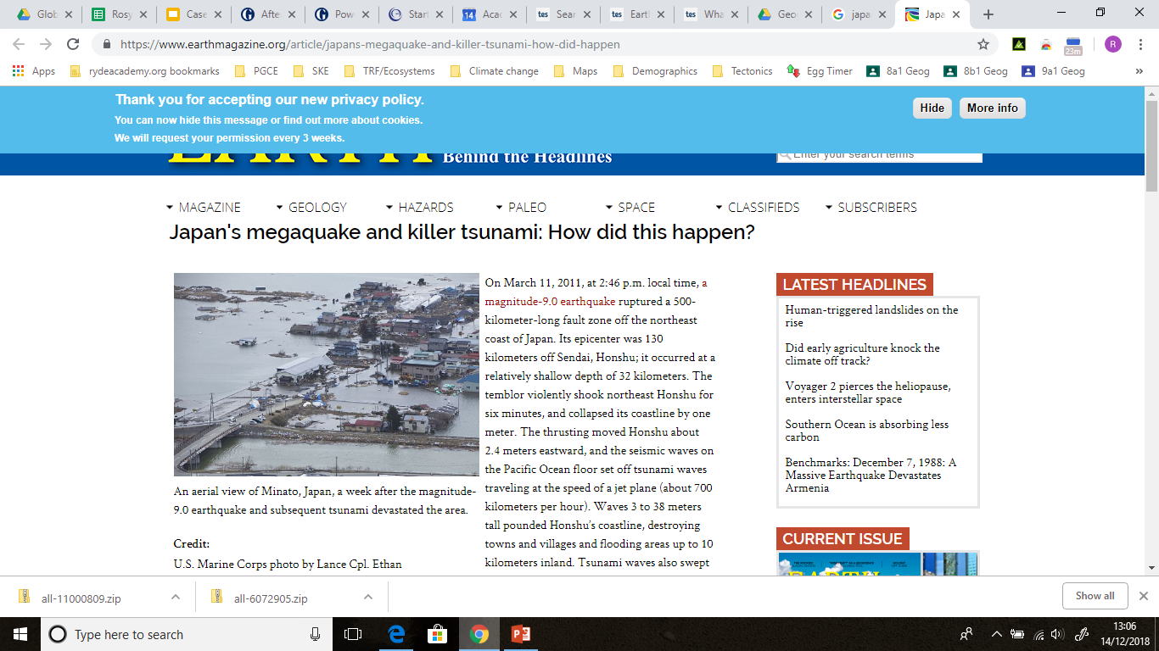

Case study: Japan 2011
Title: Why is Japan so vulnerable to Earthquakes?
LO: Why was Japan so badly affected by the 2011 earthquake and what makes the country vulnerable to earthquakes?
So why is Japan vulnerable to seismic activity, including
earthquakes, tsunamis and volcanic eruptions?
Think about:
Location: Where is Japan in relation to tectonic plates?
Tectonic activity: How does the movement of these plates cause earthquakes?
Tsunamis: How can undersea earthquakes create tsunamis?
Volcanoes: How does plate movement lead to volcanic eruptions in Japan?
Impact: How do Japan’s geography and population make it more at risk?
Notes:
https://dashboard.blooket.com/set/691185024a7fdf5a96561d67

